Slide 1

Analysis: Airline On-Time Statistics and Delay Causes
Immanuel Albrecht

Slide 2
Outline
Me
The Data
Insights

Slide 3

About Me
(Contents of this slide have been removed, because of irrelevance.)

Slide 4
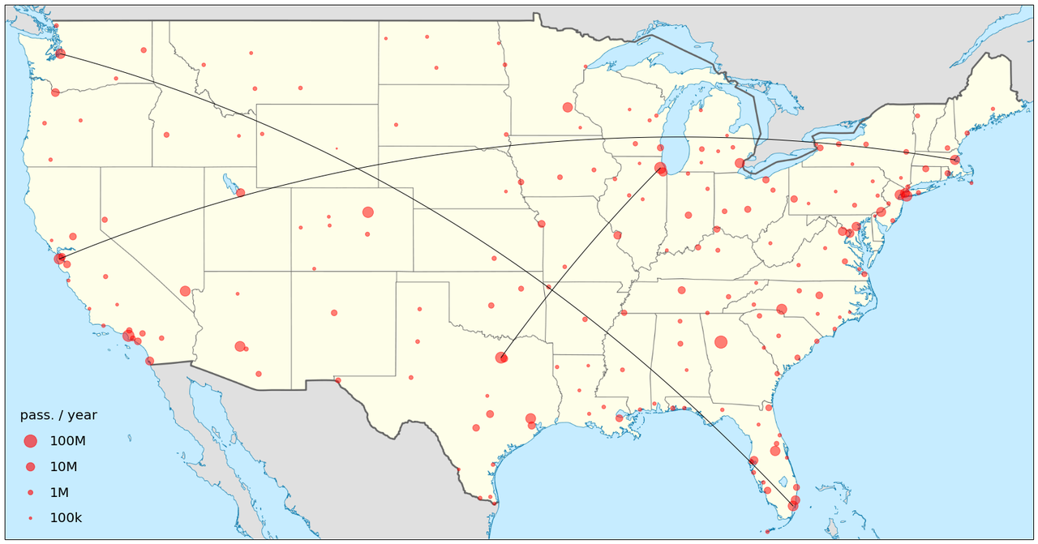
The Data
This Photo by Unknown Author is licensed under CC BY-SA

Slide 5

Data Source
Source: US Bureau of Transportation Statistics
All carriers with 0.5%+ of the total US-domestic scheduled-service passenger revenue are required to report to the BTS.
Counts of arrived (total, delayed), cancelled, and diverted flights
Classification of causes of 15+ min delayed arrivals
Sum of delay minutes per cause
Individual counts/sums for carrier, month, airport
NOT IN THE DATA
non-revenue passenger flights (military, government,...)
cargo flights
chartered/private flights (no public schedule)

Slide 6

Data Sets
XX data set
73211 rows with complete data
Top 30 US airports
June 2003 – December 2020
3 column titles have leading whitespaces
data is the same as directly obtained from BTS
720 rows with missing data
316979 rows with complete data
June 2003 – March 2022
420 US airports
BTS data set
weird trailing comma on each line
... with CSV quality issues
71 rows with missing data
This Photo by Unknown Author is licensed under CC BY-SA-NC

Slide 7

Data Preparation
remove any data rows with missing values, without weight-correction (.9977 survival rate)
add day counts for each month (total, Mondays, Tuesdays, ...)
add full-year of data indicator for 2004 – 2021
add top 30 airport indicator
add months-from-May 2003 column (t)

Slide 8

Descriptive Statistics

Slide 9
# Airports Operating
Donald Trump inaugurated Jan 20, 2017

Slide 10
# Carriers Operating

Slide 11
# Flights Operated
Donald Trump inaugurated Jan 20, 2017

Slide 12
# Flight Operated (CoViD-19)

Slide 13

Impact of CoViD-19 on Delays?

Slide 14
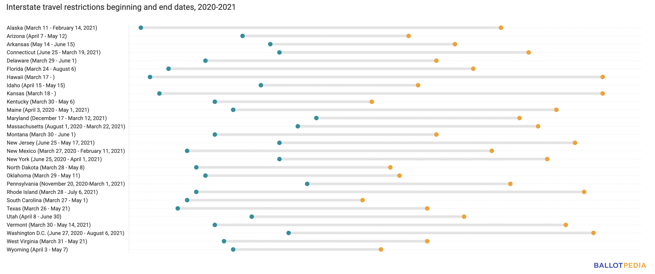
Timeline CoViD-19
Mar 21, 2020: Trump suspends entry of foreign nationals to the US
Mar – May 2020: most states with restrictions have issued their interstate travel restrictions
Aug 2021: restrictions lifted
March 2020
– July 2021

Slide 15

Control Data
Mar 2018 – July 2019
well after the Trump-bump
well before any CoViD-19 impact
comparable yearly seasonality

Slide 16
Setup
compare the ratio of delayed flights / total flights
compare the average delay in minutes
CoViD-19 Data
Control Data
2020/03 – 2022/07
518 days, Sun – Sat
6034 obs. (airport x month)
median delay ratio: .09
75th quantile: .14
median delay: 55 min
2018/03 – 2019/07
518 days, Thu – Wed
5897 obs. (airport x month)
median delay ratio: .18
25th quantile: .14
median delay: 66 min
<
<
Wilcoxon: true shift

Slide 17

Less Flights – Less Delay?

Slide 18
Control
CoViD-19

Slide 19

Regression Analysis

Slide 20

Case for Logistic Regression
categorial dependent variable: delayed or not delayed
observing rates of delayed instances per airport and month
CDF looks like an S-curve
Transform response with $y^{′}=\ln{\frac{y}{1−y}}$
Robust Linear Regression

Slide 21

Caveats
rate observations of exactly 0 and 1 are removed from the data, without weight correction (<0.012 observations)
delayed continuation of journeys violates the independence assumption between observations (multiple counting of same event)
residuals are not normal distributed, heavy-tailed
central limit theorem may be violated
model may be misspecified, relevant variables may be missing

Slide 22


Model Selection
CoViD-19 and Control months only
full variable model (airports, months, extra weekdays, covid, but no top30)
only keep variables that have $\left|t\right|>5$
iterate until all variables are kept
check and add top30 indicator
This Photo by Unknown Author is licensed under CC BY-NC-ND

Slide 23

Fitted Model Parameters
 | Value | Std. Error | t value
(Intercept) | -1.66 | 0.02 | -99.85
covid | -0.67 | 0.01 | -68.55
sep | -0.43 | 0.02 | -19.50
mar | -0.29 | 0.02 | -17.05
feb | 0.41 | 0.03 | 16.35
apr | -0.29 | 0.02 | -16.21
oct | -0.34 | 0.02 | -14.97
extra_sat | 0.24 | 0.02 | 14.68
ADK | 1.61 | 0.11 | 14.24
extra_tue | 0.22 | 0.02 | 13.87
ITO | -1.22 | 0.09 | -13.67
arr_flights_n | 1.28 | 0.09 | 13.55
may | -0.22 | 0.02 | -13.21
top30 | -0.36 | 0.03 | -12.43
CDB | 1.40 | 0.13 | 10.45
extra_thu | 0.13 | 0.01 | 10.33
jul | 0.17 | 0.02 | 10.06
EKO | -0.91 | 0.10 | -9.46
jan | -0.21 | 0.02 | -9.39
LIH | -0.82 | 0.09 | -9.20
HIB | -0.82 | 0.09 | -8.97
BTM | -0.79 | 0.09 | -8.71
ATL | -0.82 | 0.10 | -8.21
KOA | -0.70 | 0.09 | -7.86
BJI | -0.65 | 0.09 | -7.30
LWS | -0.62 | 0.09 | -6.89
BQN | 0.76 | 0.11 | 6.84
OTZ | -0.63 | 0.09 | -6.77
PIH | -0.60 | 0.09 | -6.69
ABR | -0.57 | 0.09 | -6.14
ELM | -0.57 | 0.09 | -6.00
OGG | -0.53 | 0.09 | -5.98
This Photo by Unknown Author is licensed under CC BY-ND

Slide 24
Model Interpretation
More flights cause higher delay rates:
40% increase of delay risk when going to the average top 30 airport compared to the average non-top airport due to higher number of flights
YES: less flights mean less delay
Top 30: 16% decrease of delay risk due to less flights during pandemic, but...
 | Value | t value
arr_flights_n | 1.28 | 13.55

Slide 25
Additional CoViD-19 Effect
additional 45% decrease of delay risk after accounting for less flights during the pandemic
possible non-linear relationship between number of arriving flights and delay rate
hints at a different airline world during a pandemic
 | Value | t value
covid | -0.67 | -68.55

Slide 26

Airport Effects...
Top 30 (except ATL) have 27% less delayed arrivals than normally expected
ATL even has 65% (!) less delayed arrivals than normally expected
(Atlanta is the biggest passenger airport in the world)
This Photo by Unknown Author is licensed under CC BY-NC

Slide 27
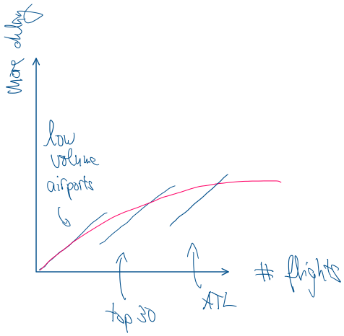

Non-linear Effect?
linear: BIC=20,354
linear+$x2$: BIC=20,317
$log⁡(x)$: BIC=20,391
$√x$: BIC=20,284

Slide 28

Square-Root Model vs. Linear Model

Slide 29
categorial effects are very similar between models
same holds for other non-linear models of the flight-delay relationship

Slide 30

Summary
CoViD-19 has positive effect
Top 30 airports are better destinations for impatient travelers
Atlanta is probably a good choice for connection flights
Hawaii has less delayed arrivals (lots of short flights between islands?)
Pacific Islands of Alaska are notoriously delaying destinations
Don’t interpret season/weekday factors in this model

Slide 31

Season/Weekday Model
data from 2004-2019
observe rate of delayed flights for each month, logit transformed
robust linear model, months and extra-day count as variable
Shapiro-Wilks & Jarque-Bera: residuals are normal distributed

Slide 32
Yearly Seasonality
more delays
less delays

Slide 33
Weekly Seasonality
more delays
less delays

Slide 34
That’s all, folks!

